Slide 1


3 Model
Guido Borghi, PhD
guido.borghi@unibo.it

Slide 2
Recalling the Machine Learning pipeline
In these slides we focus on the model, the real “heart” of the AI in our system
It is one of the most delicate and decisive elements of the entire process:
Here, with the word “model”, we refer to the “mechanism” with which input data are transformed in outputs
Usually, this “mechanism” is based on math, geometry, statistics, …
Remember that the other steps are also important: even having the best classifier available, if I use “dirty” (not correctly pre-processed) or insignificant input data, the system will perform poorly.
DATA ACQUISITION
DATA PROCESSING
MODEL
PREDICTION

Slide 3
3.1 Machine Learning Tasks
Classification
Regression
Clustering

Slide 4

Machine Learning tasks
There are different tasks in ML → depending on the output that we want:
Classification, regression and clustering
Classification:
Given a specific input, the model (classifier) outputs a class (pattern → class).
If there are only 2 classes, we call the problem binary classification
If there are multiple classes (>2), we call the problem multi-class classification
What is a class (the output of the classification task)?
A data set having common properties
The concept of class is related with the concept of “label” previously introduced
Different labels can be grouped in a single class.
The concept of class is semantic, since it strictly depends by the working context
Examples:
Classification of italian letters → 21 classes
Classification of italian/indian alphabets → 2 classes
→ In our exercises, we will tackle classification tasks.
Data
Classifier
Cat
(class)

Slide 5
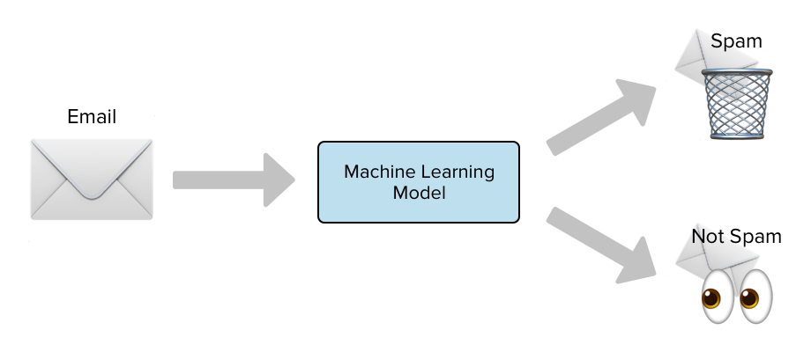
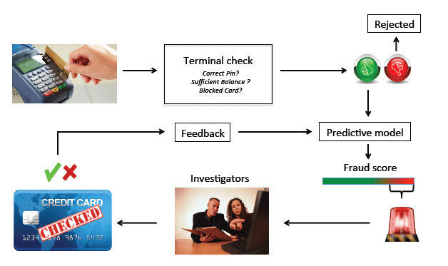
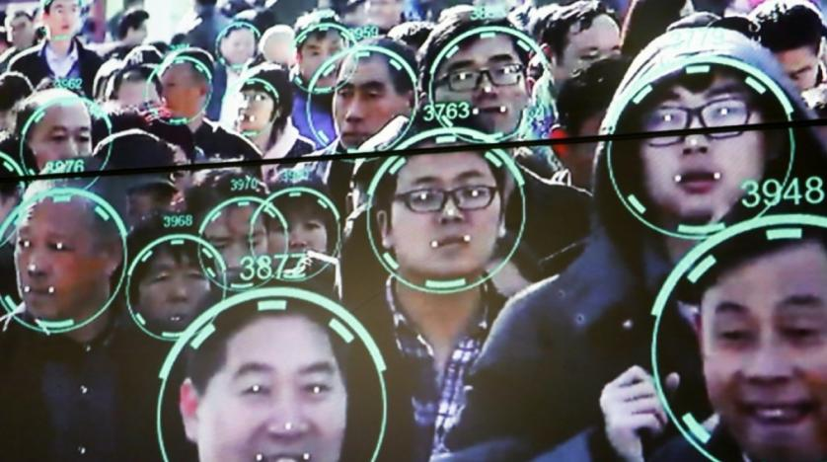
Machine Learning tasks: Classification
Spam Detection
Data: email texts
Classes/labels: yes/no (spam)
Credit Card Fraud Detection
Data: list of the bank operations
Classes/labels: yes/no (fraud)
Face Recognition
Data: images
Classes/labels: identity
Medical diagnosys
Data: x-ray images
Classes/labels: benign/malignant (tumor)

Slide 6
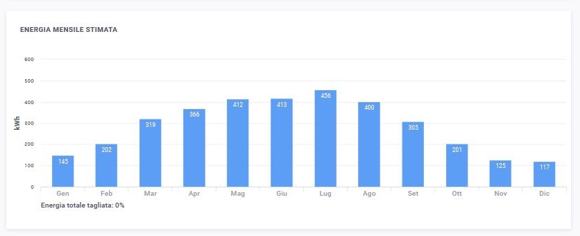
Machine Learning tasks
Regression:
Given a specific input, the model (regressor) outputs a continuous value (data → value)
You can see a regression task as a classification task with a (very) high number of classes.
Usually, regression models != classification models
Examples of regression tasks:
Estimation of a person's height based on weight
Estimation of the sale prices for apartments in the real estate market
Risk estimation for insurance companies
Energy prediction produced by a photovoltaic system
Health costs prediction models
Data
How many modules?
Latitude, longitude
Orientation (w.r.t sun)
…
Regressor

Slide 7
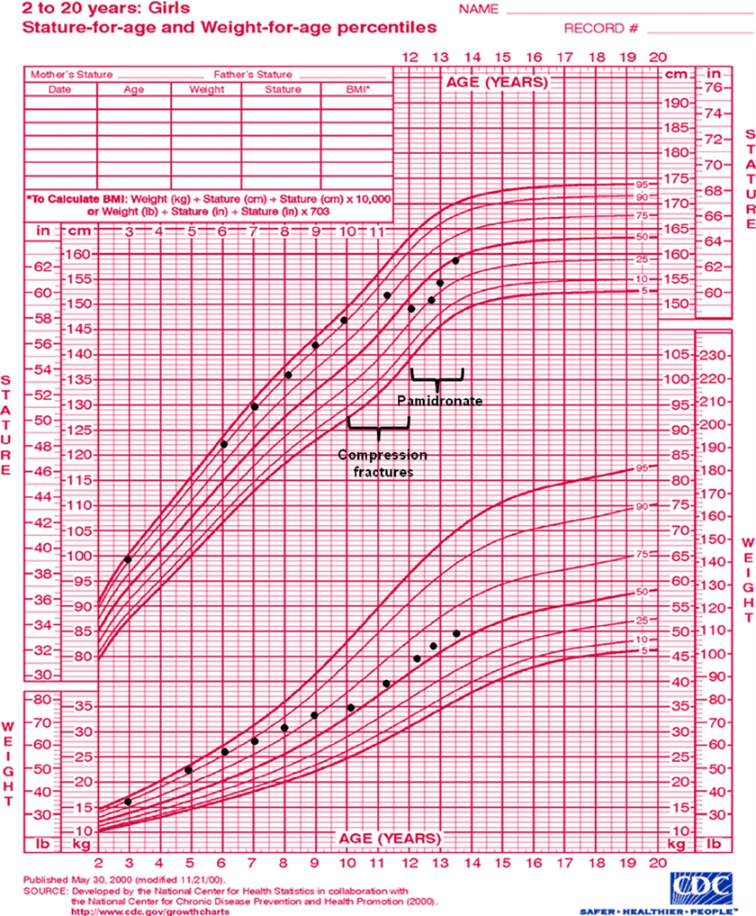
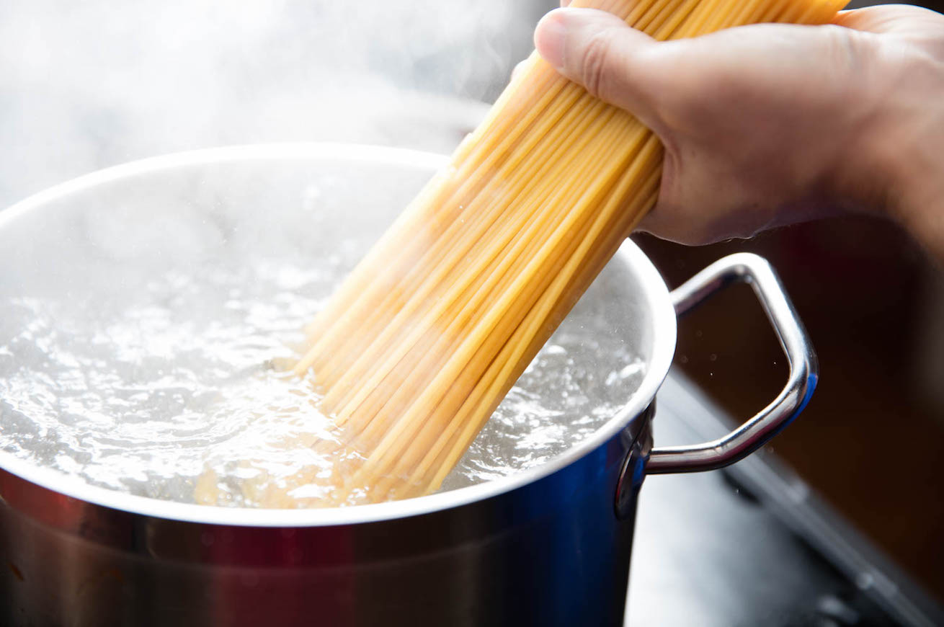
Machine Learning tasks: Regression
You can see the growth percentiles as a tool to perform regression in order to predict, for instance, the future height or weight.
How much pasta should I put if I have 5 guests (2 adults and 3 children)?

Slide 8
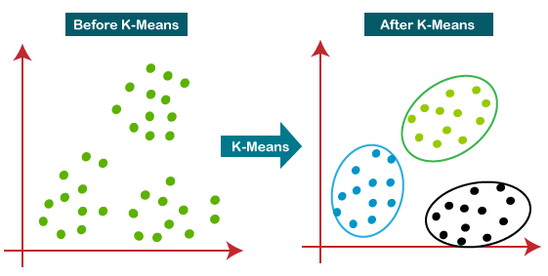
Machine Learning tasks
Clustering:
Identify groups (clusters) of data with similar characteristics.
Clustering is often applied in an unsupervised learning setting, in which the patterns are not labeled and/or the classes of the problem are not known in advance.
Usually, the unsupervised nature of the problem makes it more complex than classification.
Often, even the number of clusters is not known a priori.
The clusters identified can be used as classes.
Clustering examples:
Marketing → definition of user groups based on consumption
Genetics → grouping of individuals based on DNA analogies
Bioinformatics → partitioning of genes into groups with similar characteristics
Vision → unsupervised segmentation
Raw Data
Cluster 1
Cluster 2
Cluster 3

Slide 9
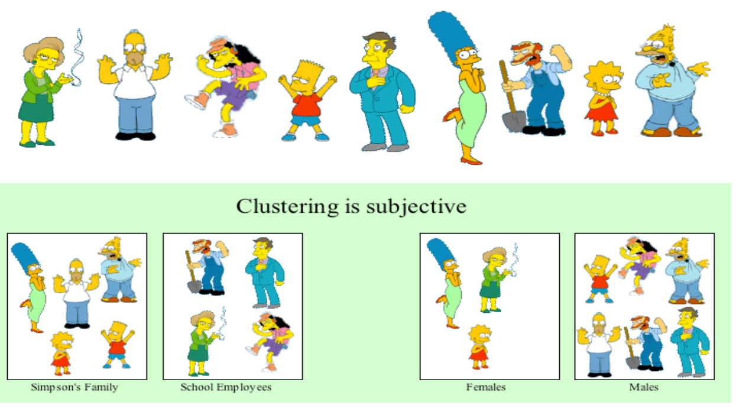
Machine Learning tasks: Clustering

Slide 10

Machine Learning tasks
For the Artificial Vision domain, we can identify even more specific problems:
Classification: (as before)
Localization: classification + object position in the image (through a bounding box)
Detection: multiple object classification + localization (through more bounding boxes)
Segmentation: each pixel in the image is classified

Slide 11
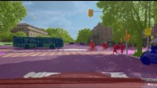
Example of Segmentation
https://youtu.be/X8vSk8R_zTA

Slide 12
3.2 Classification through a set of explicitly programmed instructions
Pattern Recognition
Expert Systems

Slide 13
Definitions
Pattern Recognition: the discipline that studies the recognition of patterns (“data samples”) even with pre-programmed algorithms (not able to learn automatically).
No learning phase!
The “model” is a set of hand-crafted instructions (if-then-else paradigm)
Actually, the term Pattern Recognition is generally used to refer AI algorithms
DATA ACQUISITION
DATA PROCESSING
MODEL
PREDICTION

Slide 14
Explicitly programmed instructions
Technique similar to the Expert Systems developed in the ‘80s (→ AI History)
A first form of Artificial Intelligence.
The ability of a calculator to perform (simple) calculations on large amounts of data is exploited.
The programmer develops a series of instructions to solve a specific problem:
These instructions are typically based on if-then-else statements
A strong prior knowledge of the problem is required
In our case*: how to understand only from coordinates if the shape is a square, rectangle, triangle or rhombus?
What are the tasks that can be faced with the explicitly programmed instructions?
The conditions are stable and known a priori → constrained industrial environments
There are mathematical formulas to model the problem
The problem must be limited in dimensionality and “not too complex”
…
* With the Euclid dataset

Slide 15
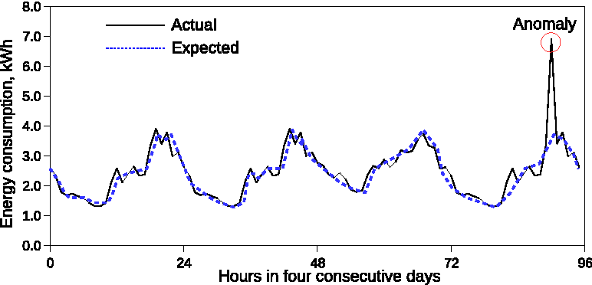
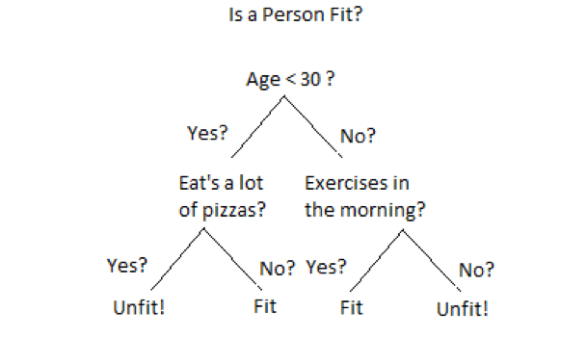
Examples
Anomaly prediction with
explicitly programmed instructions
Fit/Unfit prediction with
explicitly programmed instructions
Threshold
We observe anomalies when the value:
Is greater than a given threshold.
We can define the threshold as the mean value of the last 3 peaks.
The rate of change of the function is too fast.
…

Slide 16
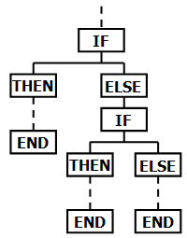
Explicitly programmed instructions
General considerations about PR:
It can achieve a high degree of success:
If a priori knowledge is adequate → In our case, we have geometrics knowledge
Dimensionality of the problem is limited → In our case, only few coordinates (6 - 8)
The test domain is similar to what was assumed when defining the instructions
The developed solution will inevitably be (too) specific:
In our case: what happens if a new trapezoid class is introduced?
Technical considerations about PR:
There is not a real learning phase → no training data is needed, all data for val/test.
It is possible to understand why the developed system fails in classification.
If the problem becomes complicated, the programming time increases.
The code risks becoming unmanageable due to:
High complexity and number of innested statements
Length of the code
Too specific functions

Slide 17

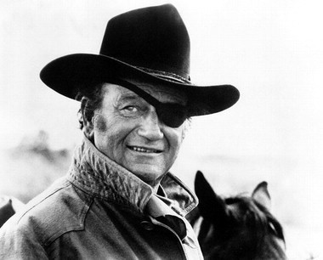
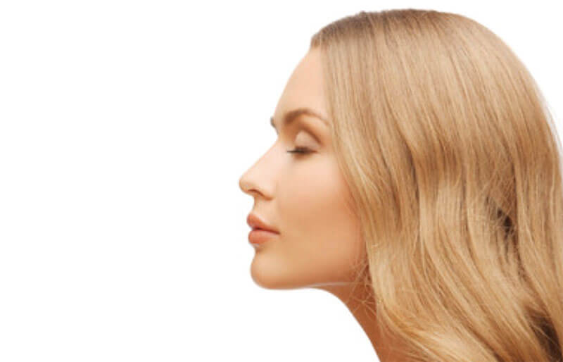

Limits of programmed instructions
Task: Face Detection → Is there a face in the image?
Image → high dimensionality (128 x 128 x 3 = ~50k values)
It is easy for humans to “define” what a face is, but for a computer?
What is an eye? A nose? A mouth?
Assuming we can define these facial elements, what rules can we write?
“A face consists in two eyes with under a nose and again under a mouth”
Here maybe we can identify a face
But here?
And here?
And here?

Slide 18
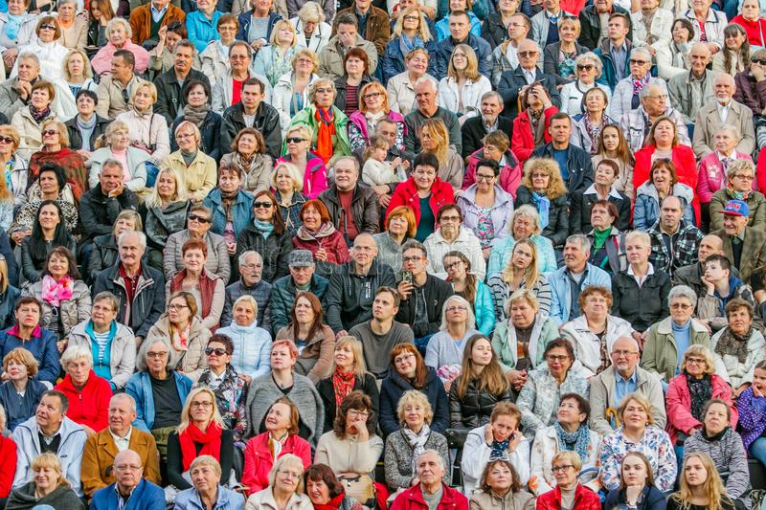
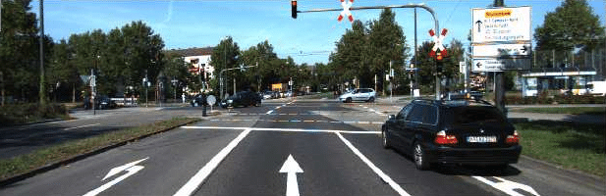

Limits of programmed instructions
Other high-complexity problems:
Classification of traffic light light
Classification of road signs
And here?
In short, solving these problems with instructions is very complex, if not impossible
The level of generalization of the proposed solution would be very limited
It is necessary, when needed, to address the problems with other paradigms!
The machine has to learn by itself how to solve a problem!

Slide 19
3.3 Classification with Machine Learning
The machine learns by itself how to solve a problem

Slide 20

How can machine learn?
A machine can learn:
From data!
For that reason, data is so relevant today.
Also humans can learn from data:
Currently, we can program machines that imitate this way of learning of humas
Remember that humans learn in many different (and efficient) ways, we only (badly) imitate just one.
“Learning from data” is similar to humans learning to play a musical instrument (humans → machines):
I must observe how a chord is created → annotated data
I have to repeat the chord several times → iterative learning process
Someone has to tell me if I’m repeating it well → loss function

Slide 21

How can machine learn?
From a practical point of view, these are the required steps:
We get the annotated data (we are in the Supervised Learning setting)
We pre-process data, making them suitable for the algorithm we want to use
We iteratively train a classifier
We measure the performance of the implemented solution
We are going to use the scikit-learn library, developed for ML
Now we just have to introduce (some) classifier models:
We will not study clustering (already seen at Data Mining)
You have already seen some classifiers at Data Mining
We will see how to measure system performance

Slide 22
3.3.1 Support Vector Machines
SVMs

Slide 23
Support Vector Machines (SVMs)
A supervised learning method used for classification, regression and outliers' detection.
Effective in high dimensional spaces.
Still effective in cases where number of dimensions is greater than the number of samples.
Key ideas of SVMs (linear case):
Classification → linearly separate patterns
Hyperplanes, they are a decision surface
y2
Which separating hyperplane?
In general, lots of possible solutions for a,b,c (an infinite number!)
SVM finds an optimal solution!
Pattern class A
Pattern class B
y1

Slide 24
Support Vector Machines (SVMs)
y2
y2
y1
y1
Support vectors, the data points that lie closest
to the decision surface (or hyperplane).
These are data points most difficult to classify
They directly influence the optimum location of the decision surface
They are the elements of the training set that would change the position of the dividing hyperplane if removed
SVMs maximize the margin between support vectors
The decision function is fully specified by a (usually very small) subset of training samples, the support vectors.
This becomes a Quadratic programming problem that is easy to solve by standard methods
Lagrange multipliers
If you are interested in mathematical details: https://web.mit.edu/6.034/wwwbob/svm-notes-long-08.pdf

Slide 25
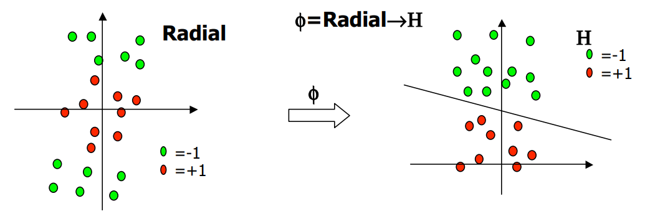
Support Vector Machines (SVMs)
What if patterms are not linearly separable?
The idea is to gain linearly separation by mapping the data to a higher dimensional space
The mapping procedure is realized through a kernel function
What if we have more than 2 classes?
One-Against-One: classifiers trained on all possible class couples; a pattern is tested by each classifier that asisgn a vote; the class with the majority of votes is taken (majority vote rule).
One-Against-All: one SVM trained for each class (in which the secon class is the set of the other classes). At testing time, the SVM that has the better margin decides the final class.
https://en.wikipedia.org/wiki/Kernel_method

Slide 26
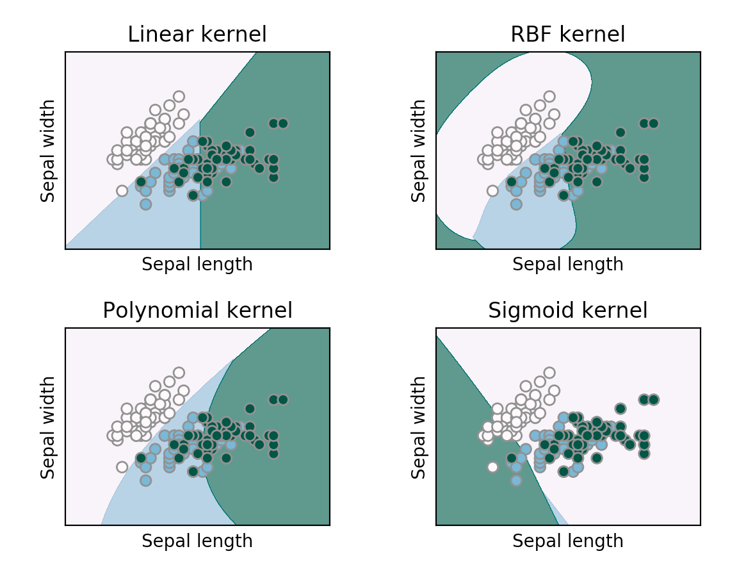
Hands on SVMs
Linear or non-linear kernel?
If the dimensionality of the space is very high (e.g., 5000 features), linear SVM is generally used
For low dimensionality (e.g., 20 features) the primary choice is non-linear SVM with RBF kernel
For medium dimensionality (e.g., 200 features) both types are generally tried
Remember, the hyperparameters are calibrated on a separate validation set, or through cross validation
https://scikit-learn.org/stable/modules/generated/sklearn.svm.SVC.html

Slide 27
3.3.2 Decision Trees
DTs

Slide 28
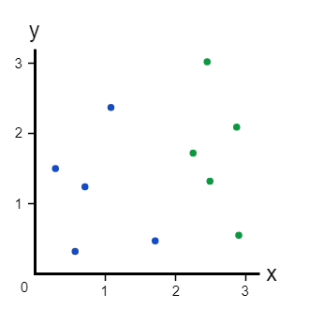
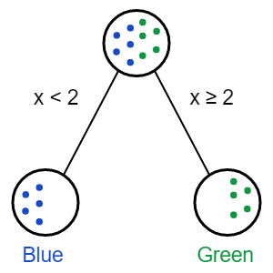
Decision Tree
Tree-like model to perform the final classification.
Decision trees are commonly used in operational research, specifically in decision analysis.
Try to define when a data point belongs to class 1 (blue) or class 2 (green)
Probably, you just evaluated a decision tree in your head
Test
Decision Tree
https://victorzhou.com/blog/intro-to-random-forests/

Slide 29
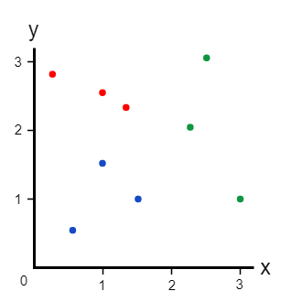
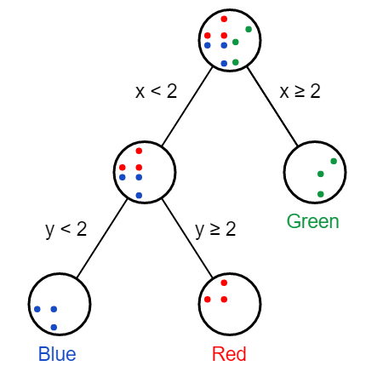
Decision Tree
What happen if we add a class?
Our old decision tree doesn’t work so well anymore!
We need to add another decision node
Root Node
Test A
Test B
Test B
Intermediate Nodes
Leaf
Nodes
Test A

Slide 30
Decision Tree: training
The root node:
We want a decision node that makes a “good” split → separating different classes as much as possible.
But how do we quantify how good a split is? → we need a measure → Gini index, entropy, information gain, …
Different possible algorithms (ID3, C4.5 and CART) that recursively evaluating different features and using at each node the feature that best splits the data.
The second node:
Let’s (arbitrarily) go to the left branch
We’re now only using the data that would that “belong” to the left branch
We just do the same thing as in the root node!
We apply this procedure to all the other nodes
The predicted category would be the category on the leaf node
When to stop the training?
When the selected measure is not further increased

Slide 31
3.3.3 Ensemble Methods
Bagging → Random Forest
Boosting → Adaboost

Slide 32
Ensemble methods: combine linear classifiers
A multi-classifier is an approach where several classifiers are used together:
In parallel
In cascade
It has been shown the use of combinations of classifiers can strongly improve performance
In practice, investing (a lot of) time in “extremely” optimizing a single classifier is generally not convenient.
The combination is effective only when individual classifiers are (at least partially) independent:
Using different features, different algorithms for feature extraction, different classification algorithms, ...
Unfortunately, it is very difficult to have real independence between classifiers
Two approaches:
Bagging: I train the same classification algorithm on different portions of the training set
Boosting: I focus the training on incorrectly classified patterns

Slide 33
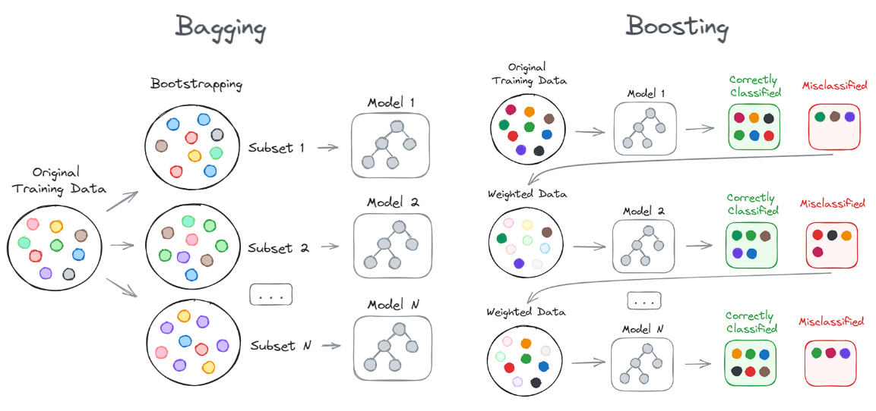
Bagging vs Boosting
random sampling with replacement
Image credits: https://pub.towardsai.net/bagging-vs-boosting-the-power-of-ensemble-methods-in-machine-learning-6404e33524e6

Slide 34
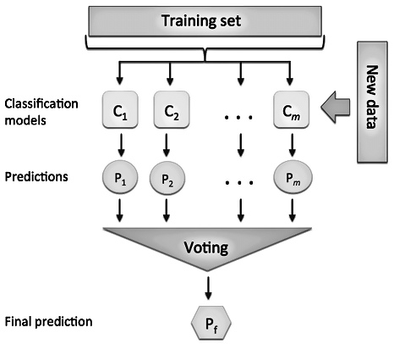
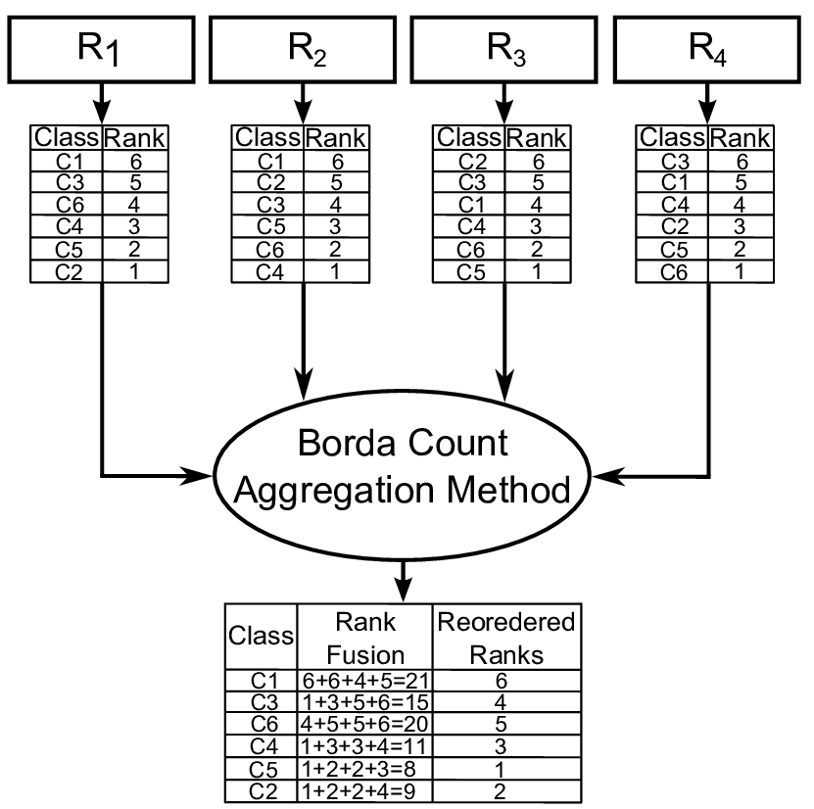
Ensemble methods
How to merge decisions of the individual classifiers :
Decision level
Majority vote rule
Each classifier votes for a class.
The pattern is assigned to the highest rated class.
Borda count
Each classifier produces a ranking of the classes
The rankings are converted into scores.
The class with the highest final score is the one chosen.
https://en.wikipedia.org/wiki/Borda_count

Slide 35
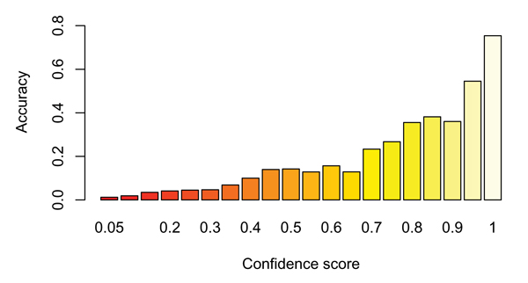
Ensemble methods
Confidence level
Each classifier outputs a confidence value, and these values are merged with different function: sum, product, min, max, …
Weighted sum: the sum of the confidence values is performed by weighing the different classifiers according to their degree of skill.
NB: in practice, the sum is often preferable to the product as it is more robust.
Indeed, in the product it is sufficient that a single classifier indicates zero confidence to bring the confidence of the multi classifier to zero!

Slide 36

Random Forest
Proposed in 2001, based on bagging
The single classifier is a Decision Tree (DT):
Hundreds or even thousands of DTs for each forest
2 types of bagging:
Data bagging: RF repeatedly selects a random sample with replacement of the training set and fits trees to these samples.
Feature bagging: in each decision node, the choice of the best feature on which to partition is not made on the entire set of 𝑑 feature (dimensionality of the patterns), but on a random subset.

Slide 37
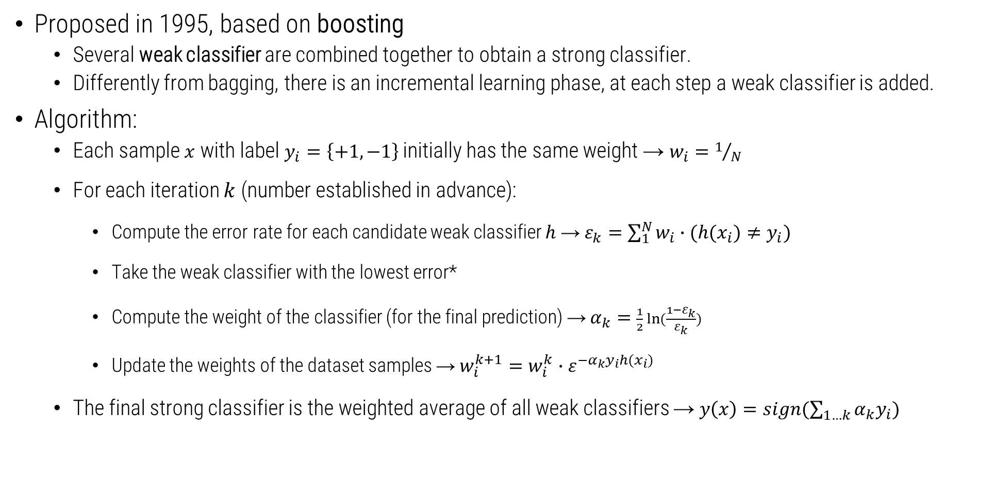
Adaboost
Proposed in 1995, based on boosting
Several weak classifier are combined together to obtain a strong classifier.
Differently from bagging, there is an incremental learning phase, at each step a weak classifier is added.
Algorithm:
Each sample $x$ with label $y_{i}=\left\{+1, −1\right\}$ initially has the same weight → $w_{i}=1/N$
For each iteration $k$ (number established in advance):
Compute the error rate for each candidate weak classifier $h$ → $ε_{k}=\sum_{1}^{N}{w_{i}∙(h(x_{i})≠y_{i})}$
Take the weak classifier with the lowest error*
Compute the weight of the classifier (for the final prediction) → $α_{k}=\frac{1}{2} ln⁡(\frac{1−ε_{k}}{ε_{k}})$
Update the weights of the dataset samples → $w_{i}^{k+1}=w_{i}^{k}∙ε^{{−α}_{k}y_{i}h(x_{i})}$
The final strong classifier is the weighted average of all weak classifiers → $y\left(x\right)=sign(\sum_{1…k}{α_{k}y_{i}})$
*Another version of the algorithm is with data sampling (if wrongly classified) with replacement

Slide 38
3.4 Classification with Machine Learning and Feature Descriptors
Histogram of Oriented Gradients
Local Binary Patterns

Slide 39


Feature Descriptors
The learning phase is complex with high-dimensionality data as images
For instance, what if in input we have RGB images?
A first solution could be to “unroll” each image and to use each pixel’s value as input value:
The input dimensionality explodes: 224 x 224 x 3 = ~150k values!
The classifier receives too many values, it is not trivial understand what is important and what no
A second solution is to introduce a new step in the machine learning paradigm:
Human
intervention
0,25
0,366
1,25
…
Model
High dimensional data
(image)
How to extract useful information in a “compact” way?
Feature Descriptor
(FD)

Slide 40
Feature Extraction
Feature Extraction: the extraction procedure of features from data
Feature/Feature Descriptor: an n-dimensional vector of numerical features that represent (in a discriminative way) some object (used as input data).
Actually, the terms feature and data are often interchangeable
DATA ACQUISITION
DATA PROCESSING
FEATURE EXTRACTION
MODEL
PREDICTION

Slide 41
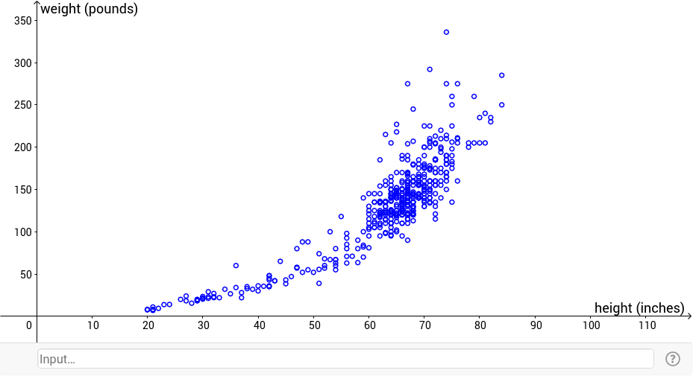
Definitions
Data: the elements contained in a set (dataset) that we are going to use in our algorithm
Each element can named as data point, observation, data sample, data.
Feature: individual characteristics or attributes used to describe and represent data points.
Also, the variables or properties that capture information about the data
The number of features is referred as dimensionality (!= the number of data)
If the dimensionality is 2, it is easy to plot and visualize the feature distribution
Examples:
In a dataset of housing prices, features could include the number of bedrooms, location, and number of bathrooms.
In a dataset of geometric shapes, features include the coordinates of the vertices of each shape
In a dataset of people, features could include only the height and the weight of each person.

Slide 42
Example of Feature Descriptor
Object A geometric shape
Data Array of values (coordinates, diagonals, …)
Feature Descriptor
A (sub)set of the coordinates
A «new value» that we can compute from coordinates
…
Object An image
Data Matrix of values (pixels)
Feature Descriptor
Unrolled or a subset of pixels
A «new value» that we can compute from pixels
...

Slide 43
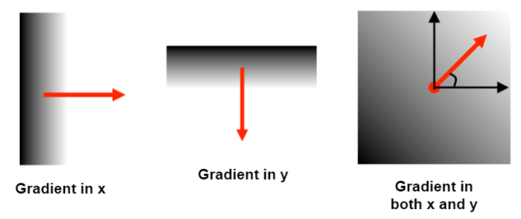
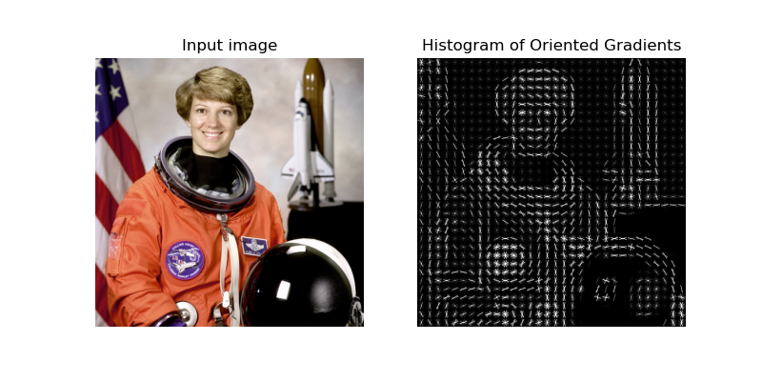
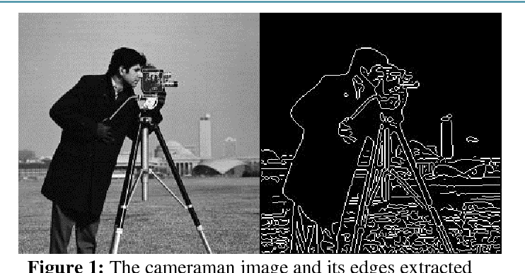
Histogram of Oriented Gradients (HOG)
A visual feature descriptor (work with images)
Good to describe the shape of an object!
HOG provides the edge direction:
The whole image is divided into smaller regions
For each region, the edge directions are calculated
Edge → curves at which the brightness changes sharply
Direction → angle and magnitude of edges
All these directions are provided through a histogram

Slide 44
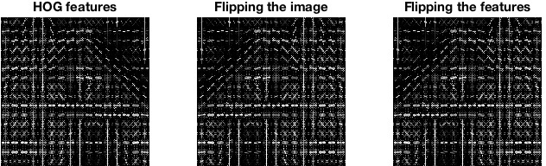
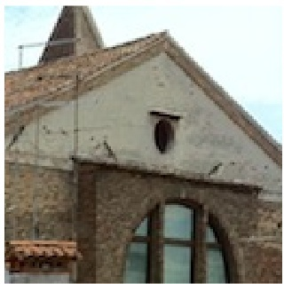
Histogram of Oriented Gradients (HOG)
https://www.vlfeat.org/overview/hog.html

Slide 45
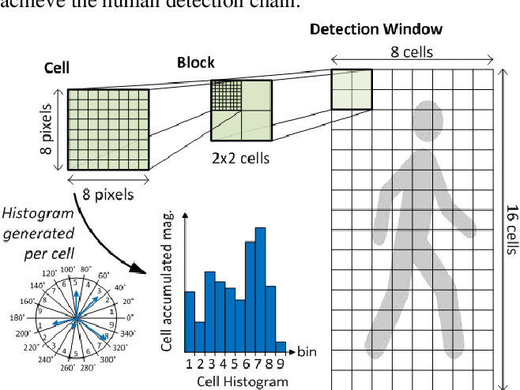
Histogram of Oriented Gradients (HOG)
hog(img, orientations=8, pixels_per_cell=(4, 4), cells_per_block=(1, 1))

Slide 46
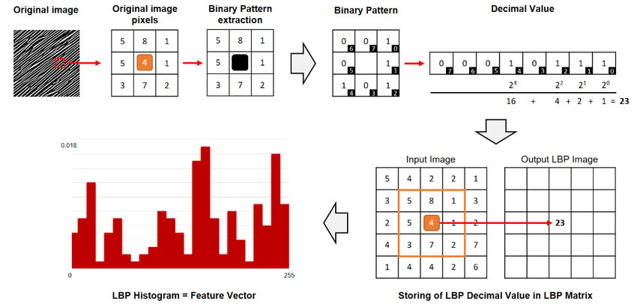
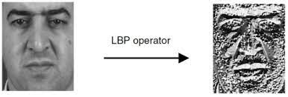
Local Binary Pattern (LBP)
A visual feature descriptor (work with images)
Good to describe the texture of the surfaces!
Texture → visual surface appearance
2 elements:
Local spatial patterns
The 3x3 neighborhood of each pixel is thresholded with the center value
Gray scale contrast measure
They are computed on different cells of the image
It has been extended to use neighborhoods of different sizes

Slide 47
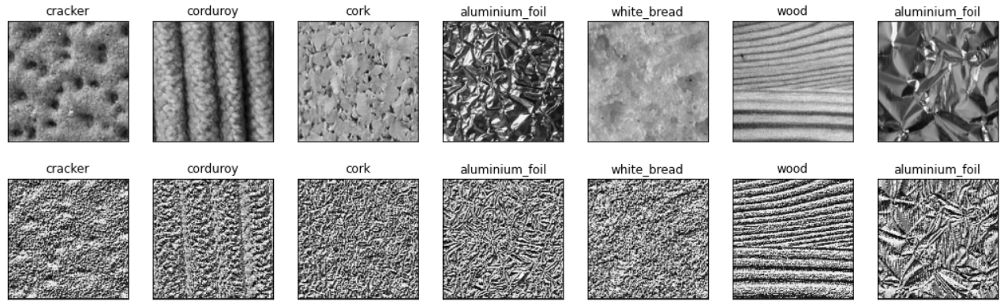
Local Binary Pattern (LBP)

Slide 48
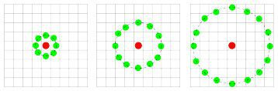
Local Binary Pattern (LBP)
local_binary_pattern(img, P=100, R=5)
P: the number of points in a circularly symmetric neighborhood to consider.
R: the radius of the circle which allows us to account for different scales.
https://pyimagesearch.com/2015/12/07/local-binary-patterns-with-python-opencv/

Slide 49
3.5 Classification with Deep Learning
From Machine Learning to Deep Learning

Slide 50
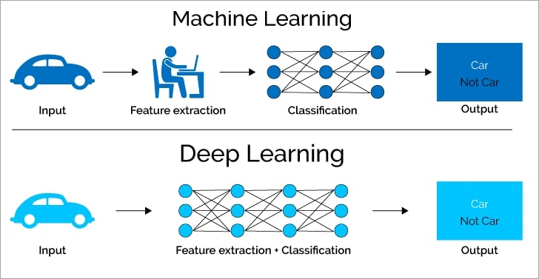
Definitions
Deep Learning: a discipline, similar to ML, that allows you to avoid the problematic phase of feature extraction (also) with high-dimensional input. Essentially, it is based on Neural Networks.
DATA ACQUISITION
DATA PROCESSING
FEATURE EXTRACTION
MODEL
PREDICTION
Human
intervention
Often, this is the weak link in the chain!

Slide 51

Neural Networks
Neural Networks (NNs): the key idea is to imitate, as far as possible, the nature.
In particular, we try to imitate the neurons of the human brain (an incredible and powerful machine!)
Several scientific studies reported the structured of the biologic neuron:
The axon primarily carries nerve signals away from the soma
Networks since neurons are connected through each others
Cell body: this is where signals are «aggregated»
Dendrites: this is where the majority of input to the neuron occurs from other cells
Path of electric signals

Slide 52
Artificial Neuron
The first scheme about the neuron has been introduced by McCulloch and Pitts in 1943
The first Artificial Neuron (AN) has been introduced by Rosenblatt in 1957
In the artificial neuron, there are:
Inputs: in our case digital numbers! (not an analog signal)
Inputs are weighted (signals are not all equally important)
Inputs are merged with a sum function (plus a bias)
An activation function is used to generate the final output:
Also the human brain filters inputs, it would be impossible to always take everything into account.

Slide 53

Activation functions
Activation functions define the output of the neuron given an input or set of inputs:
They are a sort of switches of the artificial neuron.
They outputs a small value for small inputs, and a larger value if its inputs exceed a threshold.
https://medium.com/@shrutijadon/survey-on-activation-functions-for-deep-learning-9689331ba092

Slide 54
An example of a working AN
Will I pass the Machine Learning exam?
Did I follow the lessons?
2
0,3
0,8
2x0,3 + 5x0,8 + 3x0,5
4,1
Greater than 3?
YES!
Did I study?
5
0,5
Did I really understand the topics?
3

Slide 55
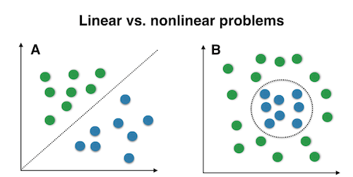
Linear vs Non-linear problems
Unfortunately, a single AN can solve only linear problems!
The solution is to use more ANs organized on different layers → Multi Layer Perceptron (MLP)
It is not so easy, since this introduces several mathematical problems
Besides, we greatly improve the computational load

Slide 56
Artificial Neural Networks
Groups of artificial neurons are organized in different layers → Neural Networks!
Tipically, are present:
An input layer (input of the network)
An output layer (output of the network)
One or more hidden layer(s)
Each neuron is fully connected with those of the next level.
Again, we try to imitate the hierarchical nature of our neurons:
We have “only” about ten levels between the retina and the actuator muscles.
Otherwise, we would be too slow to react to stimuli.

Slide 57

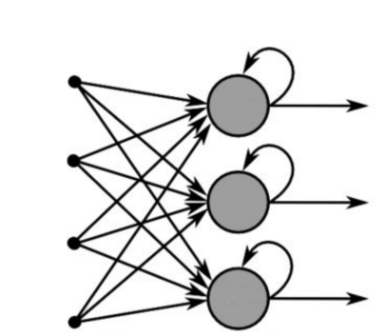
ANN typologies
Feedforward:
The connections connect the neurons of one level with the neurons of the next level
Backward connections or connections to the same level are not allowed
It is by far the most used type of network.
Recurrent:
Feedback connections are expected (generally towards neurons of the same level, but also backwards)
More suitable for the management of sequences because they have a (short-term) memory effect
In our course, we will use only FF NN!

Slide 58



Neural Networks training
General considerations about Neural Network architectures:
Greater number of hidden layers (therefore neurons) → better performance
Greater number of hidden layers (therefore neurons) → need for more training data
Greater number of hidden layers (therefore neurons) → greater computational load
How is it possible to train a neural network?
Training a neural network is extremely complicated, but we can use specific frameworks:
The same happens in Machine Learning, in which we can use the Scikit-Learn library to train own classifiers.

Slide 59
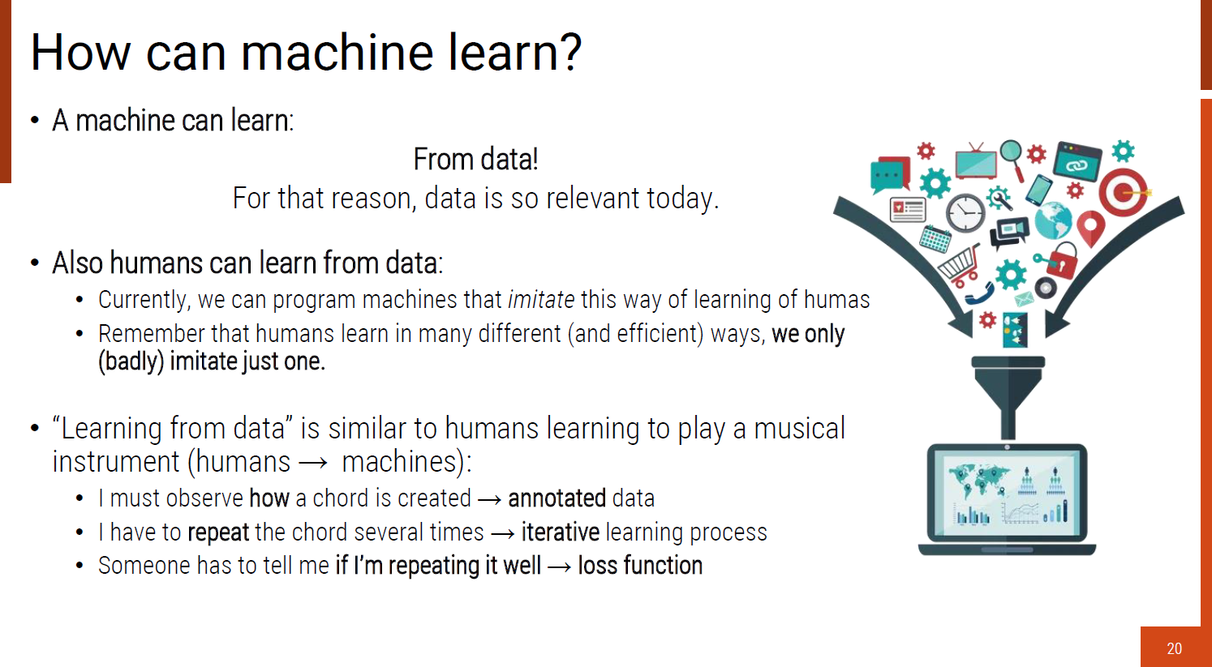
Neural Networks training
Do you remember the example of how we learn to play the guitar?

Slide 60
Neural Networks training: intuition
The same happens with Neural Networks
Repeat 1 - 4 several times
4.
Error
I have to repeat the
chord several times
1.
Input data divided in mini-batches
2.
Output
and
Labels
3.
Loss functions
I learn the chords a little at a time
Someone has to tell me if I'm repeating it well.
It represents the goal of my learning activity!
I change the position of my fingers to obtain a certain output

Slide 61
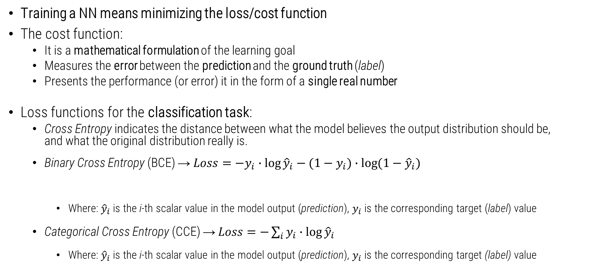
DNN Training
Training a NN means minimizing the loss/cost function
The cost function:
It is a mathematical formulation of the learning goal
Measures the error between the prediction and the ground truth (label)
Presents the performance (or error) it in the form of a single real number
Loss functions for the classification task:
Cross Entropy indicates the distance between what the model believes the output distribution should be, and what the original distribution really is.
Binary Cross Entropy (BCE) → $Loss=−y_{i}∙\log{{\hat{y}}_{i}}−(1−y_{i})∙\log{(1−{\hat{y}}_{i})}$
Where: ${\hat{y}}_{i}$ is the i-th scalar value in the model output (prediction), $y_{i}$ is the corresponding target (label) value
Categorical Cross Entropy (CCE) → $Loss=−\sum_{i}{y_{i}∙\log{{\hat{y}}_{i}}}$
Where: ${\hat{y}}_{i}$ is the i-th scalar value in the model output (prediction), $y_{i}$ is the corresponding target (label) value
This cancels out if the target is 0
This cancels out if the target is 1

Slide 62
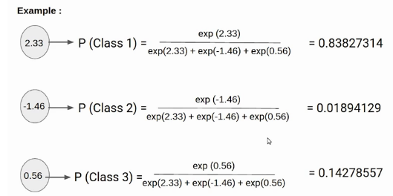

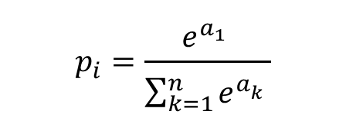
Softmax classification
In order to use the Cross Entropy loss, the output layer must output probabilities.
Then, we can use softmax layer that takes an n-dimensional vector of real numbers and transforms it into a vector of real number in range (0,1) which add up to 1.
Softmax is a continuously differentiable function.
$$1$$
Logits
$$p_{i}=\frac{e^{a_{1}^{}}}{\sum_{k=1}^{n}{e^{a_{k}^{}}}}$$
https://peterroelants.github.io/posts/cross-entropy-softmax/
https://www.analyticsvidhya.com/blog/2021/04/introduction-to-softmax-for-neural-network

Slide 63
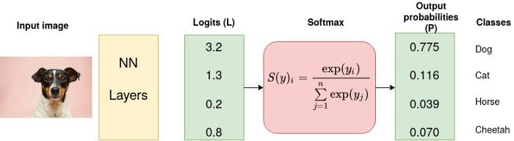
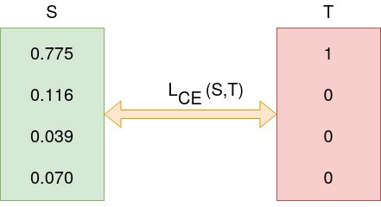
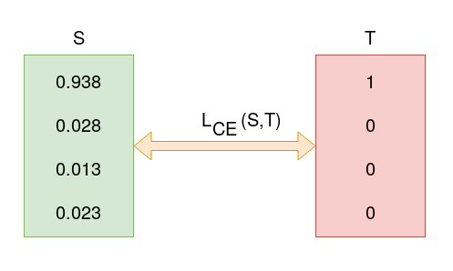
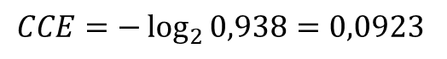
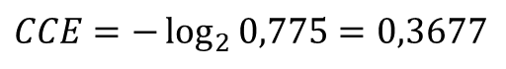
Cross Entropy
One-hot vector
One-hot vector
After some iterations…
$$CCE=−\log_{2}{0,775}{=0,3677}$$
$$CCE=−\log_{2}{0,938}{=0,0923}$$
The loss function is decreased!
https://towardsdatascience.com/cross-entropy-loss-function-f38c4ec8643e

Slide 64
DNN Training
How to minimize the loss? → adjusting (change) the weights and the bias of every neuron
https://medium.com/analytics-vidhya/backpropagation-for-dummies-e069410fa585

Slide 65

DNN Training
How to adjust weights and bias? → «following» gradients!
Why using gradients?
The derivative of a function measures the sensitivity to change of the function value (output value) with respect to a change in its argument (input value) → this is the gradient!
In other words, the gradient tells us the direction in which the function is going.
Then, we can minimize the loss function following its gradient → gradient descent approach:
$$w^{′}=w−η\frac{∂L}{∂w}$$
The new weights ($w$) are computed through the old weights ($w′$) and a certain amount of the gradient computed
Certain amount → learning rate ($η$)
A variety of gradient descent approaches (optimizers) are aviable.

Slide 66


DNN Training
Different optimizers:
Vanilla Gradient Descent
Computes the gradient of the cost function w.r.t. to the parameters for the entire training dataset
Not suggested for huge training dataset → Slow and computationally expensive algorithm
Stochastic Gradient Descent (SGD)
For each iteration, a sample of data (batch) is selected
Gradients are computed on each iteration
The path taken by the algorithm to reach the minima is usually noisier
It requires several hyperparameters
Adam
A stochastic gradient descent method
Less parameters than SGD
Computationally efficient, has little memory requirement

Slide 67

How to compute gradients
Simple case: the network has only 1 layer
We can apply a simple gradient descent technique, i.e. the delta rule (or Widrow-Hoff Rule) on the Perceptron
Alpha learning rate, g(x) is the activaction function, t is the target output, h is the weighted sum of inputs, y is the actual output and x is the input
But with one or more hidden layers is not possible to apply Delta rule!
We need an additional mechanism → backpropagation
Delta rule is a special case of the more general backpropagation algorithm
Remember that hidden layers are fundamental for Deep Learning!
Without backpropagation we cannot propagate the error, computed on the loss function, to the input of the network → the introduction of backpropagation has been fundamental in order to train DNNs!
$$Δw_{ij}=η\left({\hat{y}}_{i}−y_{i}\right)g′(h_{j})x_{i}$$

Slide 68



Backpropagation
How to compute gradients ($\frac{∂L}{∂w}$)?
The problem with DNNs is that we have hidden layers, the loss functions depends on “hidden parameters” ($w$) but we are able to observe only the output.
We can then use an algorithm to compute the gradients of the loss functions with respect to all its parameters called backpropagation, a procedure based on the chain rule.
$$\frac{d_{z}}{d_{x}}=\frac{d_{z}}{d_{y}}\frac{d_{y}}{d_{x}} , z=f\left(g\left(x\right)\right), y=g(x)$$
Chain rule

Slide 69
Backpropagation
Backpropagation is a local process. Neurons are completely unaware of the complete topology of the network in which they are embedded.
Remember: we cannot directly compute the derivative of the loss function with respect to the output of the network (it is not «visible» from hidden layers!)
We can apply the backpropagation and the chain rule to propagate the derivative of the loss function up to the inputs of the network.
Forward
(inference)
Backward
(learning)
It proceeds backwards w.r.t the flow of computations performed to compute the loss itself (hence the name).

Slide 70

Optimization procedure: a visual guide
4
The learning procedure is performed in an iterative manner, step by step. Following the gradient, the optimizers looks for the (global) minimum
2
Starting point
Output of the NN with initial (random) weights
5
Each step is proportional to the learning rate adopted
1
This surface is the solution space of the loss function
low values → low error
6
Local minimum
The loss function of DL models usually has many local minima. The solution
obtained by the final iteration may only locally minimize the loss function.
3
Global minimum
The desired goal point!

Slide 71
DNN training: summarizing
Loss function → desired goal of the NN
How?
Minimize loss function → moving close to the goal
What it means in practice?
Adjusting weights (and bias) of the NN
Through
Parameters:
Learning rate
Batch size
…
Gradient Descent → Optimizers
Based on
Backpropagation + Chain Rule
The choice of the right value of learning rate is important!
Therefore
The loss function must be derivable!!

Slide 72
Terminology in DNN training
Batch (size): the hyperparameter of gradient descent that controls the number of training samples to work through before the model’s internal parameters are updated.
Typically batch size is a multiple of the power of two (16, 32, 64, …)
Too small batch size can compromise the stability of the learning phase
The larger the batch size, the more video memory is used! (check your GPU specs)
Empirically, the batch size may be (at least) equal to the number of classes
Iteration: #iterations = the size of the training set / the batch size
Epoch: the learning procedure is applied on the entire training dataset:
One epoch means that each sample in the training has had an opportunity to update the weights
An epoch is comprised of one or more batches (or iterations).
The number of epochs is traditionally large (10, 100, 1000, …)
https://machinelearningmastery.com/difference-between-a-batch-and-an-epoch/

Slide 73

Learning Curves
It is common to create line plots that show epochs along the x-axis and the loss value of the model on the y-axis.
2 plots (usually overlapped):
One for the training
One for the validation
These plots are called learning curves.
These plots can help to diagnose whether the model has over learned (overfitting), under learned (underfitting), or is suitably fit to the training dataset.
Usually, at the beginning of the learning, the value of the loss function drops rapidly
Starting of the overfitting
Loss values (this is an error, then low values are ok for us!)
Epochs

Slide 74
MLP in Scikit-Learn
sklearn.neural_network.MLPClassifier(
hidden_layer_sizes=(100,),
activation='relu’,
solver='adam’,
batch_size='auto’,
learning_rate='constant’,
max_iter=200,
shuffle=True,
…)
https://scikit-learn.org/stable/modules/generated/sklearn.neural_network.MLPClassifier.html

Slide 75
3.5.1 Convolutional Neural Networks
CNNs: the real «core» of the current AI revolution

Slide 76

Convolutional Neural Networks (CNNs)
CNNs are particular Neural Networks specifically designed to process images
MLPs don’t scale well to full images
Instead of flatting input 3D data (let’s define as 3D also 1 channel images → ex. 224x224x1)…
…what about reshaping neurons in 3D?
3D
Input image
(224x224x1)
3D
Neurons
(3x3x1)

Slide 77

Convolutional Neural Networks (CNNs)
Unlike MLPs, CNN layers have neurons arranged in 3 dimensions:
Width (W)
Height (H)
Depth (C) → usually, greater than 1
How is possible to “connect” the 3D input with the smaller kernel (the “3D neuron set”)?
Through a mathematical operation called convolution!
The convolution is applied with a sliding-window process
Kernel
(3x3)
https://en.wikipedia.org/wiki/Convolution

Slide 78


Convolution with images
The convolution is the core building block of convolutional neural networks.
Each kernel is convolved with the input volume thus producing a 2D feature map
Usually, depth > 1 → more kernels → one feature map for each kernel is produced
The output volume is then made up by stacking all activation maps produced one on the top of the other
2x0 + 2x0 + 0x0 1x1 + 2x-1 + 1x0
2x1 + 1x1 + 1x-1
= 1
Kernel
(3x3)
Output
(Feature Map)
Image
https://stanford.edu/~shervine/teaching/cs-230/cheatsheet-convolutional-neural-networks

Slide 79

Convolution with images
Now the learnable weights (of the MLP) are grouped in the kernel!
Each cell can be viewed as a single weight to learn
1 channel image (7x7x1)
2 kernels (also called filters)
1 bias for each kernel
2 feature maps produced
3 channel image (7x7x3)
2 kernels (also called filters) applied on each channel
1 bias for each kernel
2 feature maps produced
https://cs231n.github.io/convolutional-networks/

Slide 80



Esempio di kernel che evidenzia i contorni di una immagine.
Esempio di kernel che produce un effetto embossed.
Esempi di kernel che produce un effetto blur

Slide 81

CNN Architecture
A “traditional” CNN is made up by a whole bunch of layers stacked one on the top of the other:
Pooling
layers
Input
Output
Feature Map
Feature Map
Feature Map
Feature Map
kernel
2D convolution
layers
Flatten
layer
Fully Connected layers (MLP)
Feature extractor
Classifier

Slide 82


Convolutional layer
Convolutional layers learn to extract various types of visual information in a hierarchical manner
In the layers close to the input, CNNs learn filters to extract “simple” visual information
In the layers placed in depth, the filters extract semantically complex visual information
The interesting thing is that this mechanism seems similar to what happens in our brain, where the visual cortex processes information by different layers.

Slide 83


Slide 84





Convolutional layer
Moreover, it has been experimentally verified that some learned filters are similar to the neurological stimuli of the animal brain!
In a similar way, CNNs learns filters that provide a high response (i.e. numeric value) with oriented edges!
Hubel and Wiesel discovered oriented edges cause high responses in one specific cell of the visual cortex. The edge must be in certain position and orientation.
Input
*
→
convolution
High response on edges
filters
Hubel, D.H., Wiesel, T.N.: Receptive fields of single neurones in the cat’s striatecortex. The Journal of physiology (1959)

Slide 85
Pooling layer
Pooling layers spatially subsample the input volume.
Pooling layers are widely used for a number of reasons:
Gain robustness to exact location of the features
Reduce computational (memory) cost
Help preventing overfitting
Increase receptive field of following layers
Many different functions could be used: max (most used), average, …

Slide 86


Other Layers
Activation layer → see activation functions
Flatten layer
Usually exploited to connect the 3D Feature Extractor to the 1D classifier
In input, there is a set of 3D feature maps (for instance, 12x12x64)
The 2D input is «unrolled», to fit the 1D input of the first fully connected layer
12x12x64 → 9216
It is possibile to use other techniques to join the Feature Extractor and the classifier, e.g. the Global Average Pooling layer

Slide 87

CNN architectures: the layer organization
More complex CNN architectures have recently been demonstrated to perform better than the traditional conv → ReLU → pooling stack architecture.
These architectures usually feature different graph topologies and much more intricate connectivity structures
However, these advanced architectures are out of the scope of these lectures.
In our exercitations, we are going to use well-known architectures proposed in literature:
VGG¹
ResNet²
AlexNet³
…
All these architectures can be used pre-trained (already trained on datasets like ImageNet)
1. https://arxiv.org/abs/1409.1556
2. https://arxiv.org/abs/1512.03385
3. https://papers.nips.cc/paper/2012/hash/c399862d3b9d6b76c8436e924a68c45b-Abstract.html

Slide 88
Different ways to train CNNs
From scratch
The network is trained from "0", only with an initialization of the weights
Large amount of data training required
Usually long and complex training procedure
Pre-trained
A previously trained network is used
The output is defined by the previous training
When trained on excellent datasets, excellent performance
Fine-tuned
A previously trained network is used
I keep “freezed” (unchanged ) the Feature Extractor
I made changes to the Classifier (e.g. change the number of classes)
Output
FE
C
Output
FE
C
Output
FE
C

Slide 89
3.6 Machine Learning vs Deep Learning
…and other considerations about DNNs training

Slide 90

Developing AI systems
It is not just important how well a particular classifier works
Related choices are also very important, which concern not only technical aspects but also managerial aspects, since:
They affect the project development time
They affect the amount of resources invested
They affect the need for developers
We will quickly reflect on the following questions:
How to develop an AI system?
When is better to use Machine Learning? And Deep Learning?
What about hardware for AI?

Slide 91

How to develop an AI project?
We have seen what are the main steps necessary for the realization of an AI project
Data
Data Processing (and feature extraction))
Model training
Prediction analysis (through metrics)
However, there are other important considerations:
When to address a problem through ML?
When to address a problem through DL?
What are the hardware resources needed?
What are the software resources needed?

Slide 92
Machine Learning vs Deep Learning
Element | Machine Learning | Deep Learning
Data | Large data (~ hundreds) | Huge data (~ thousands)
Accuracy | High accuracy | Best accuracy (esp. high-dimensional data)
Training time | Less time (~minutes) | Large Time (~hours, days)
Required hardware | CPU | GPU
Features | Manual | Learned
Interpretability | Good | Low

Slide 93


Machine Learning vs Deep Learning
The superiority of DL approaches than other Machine Learning algorithms manifests itself when large (huge) quantities of training data are available.
Accuracy
Deep Learning
Machine Learning
Size of training data
Not easy to identify this point…

Slide 94


Hardware for Deep Learning
The training of neural networks, especially if they are deep, requires specialized hardware:
Before starting a project with DL, you need to ask if the company/lab has the necessary hardware
Having one or more GPUs available is today a fundamental factor:
GPUs are essential for parallelizing (and therefore speeding up) calculations.
As seen, the deeper a network is, the more computational load is introduced
To date, the only usable GPUs are produced by Nvidia, a company that dominates the market:
Google has started a competition by introducing TPU (Tensor Processor Unit) on the market, but they are not yet widespread and used
The parellization of the calculations is possible thanks to the CUDA libraries (Compute Unified Device Architecture, true core business of Nvidia)

Slide 95

Training DNNs…
MODEL
TRAINING
TRAINING!

Slide 96
Hardware purchase for DL
In-house solution: the company buys the necessary hardware, it is the direct owner
Pros:
Extreme freedom of use of hardware
In the long run, it tends to have lower costs
Cons:
Hardware maintenance is required → company needs specialized technicians
Hardware ages (quickly) → necessary investments over time
For large numbers of GPUs:
It is necessary to have specific server rooms → temperature and access control
High energy consumption → consumption of the latest generation GPU: ~450W (!)
The GPU market is quite expensive and volatile:
Very few companies involved in the production process → TMSC
Semiconductor shortage
External elements influence the market: mining, wars, ...

Slide 97

Hardware for DL: in-house vs external solutions
External solution: the hardware is rented through the PaaS paradigm (Cloud)
Pros:
Hardware maintenance is NOT required
NO investment over time is required for hardware upgrades
Dedicated server rooms are NOT required, energy consumption is not borne by the company
Cons:
In the long run, it tends to have higher costs
Cons already seen for cloud-based solutions:
Vendor lock-in → it is difficult to escape from the service provider
Who really owns the data?
Privacy issues
Examples:
https://cloud.google.com/products/calculator/
https://www.leadergpu.com/#chose-best
https://buomsoo-kim.github.io/colab/2020/03/15/Google-newly-launches-colab-pro.md/
https://calculator.aws/#/addService/EC2

Slide 98
The end(?) of our AI journey
Classification
Regression
Clustering
…
Expert Systems Pre-defined rules
Don’t’ scale well
A-priori knowledge
Problem
Hundreds of annotated training data
Training data?
AI
Strategy
Scikit-Learn
Data (related to that problem)
Machine Learning Classifiers
(SVM, RF)
Numeric data → CLF → output
Images flattened → CLF → output
Images → FEATURES EXT. → CLF→ output
Supervised Learning
Thousands of annotated training data
Data acquisition
Data annotation
Public datasets
…
TensorFlow + Keras
Numeric data → MLP → output
Images flattened → MLP → output
Images → FEATURES EXT. → MLP → output
Images → CNN → output
Deep Learning Neural Networks
(MLP, CNN)

